Slide 1
A404 / 2018
Stellar Atmospheres

Slide 2
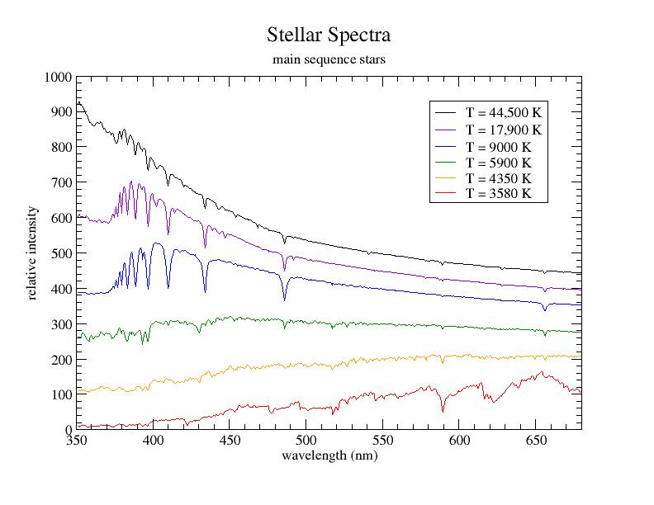
Balmer lines of H
SUN
Molecular features

Slide 3
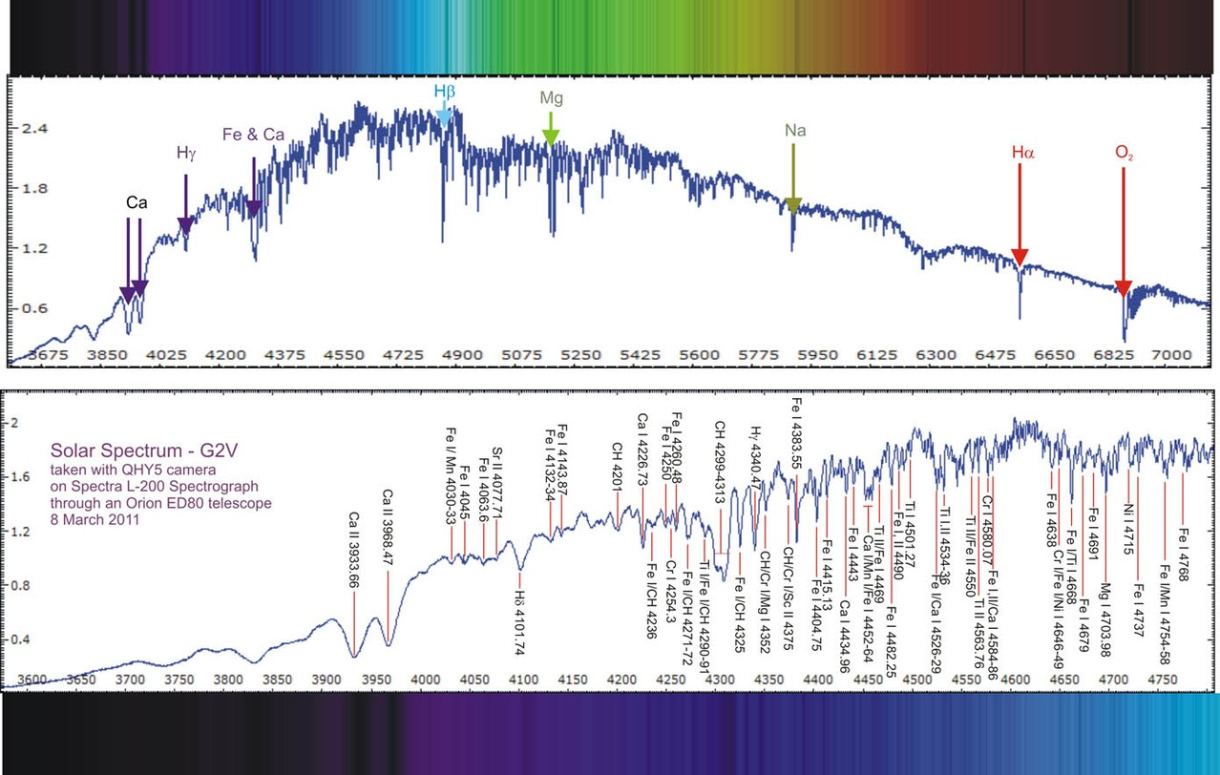
Solar Spectrum : 360 – 710 nm
Higher resolution: 360 – 480 nm

Slide 4
Why do the spectra look different with T?

Slide 5
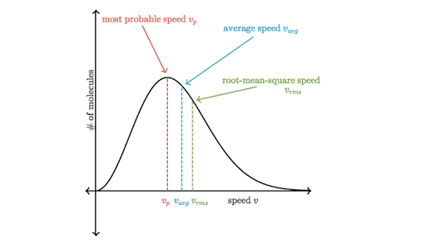
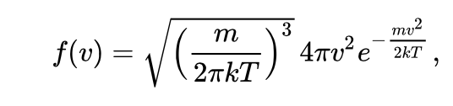
Why do the spectra look different with T?
When in thermal equilibrium

Slide 6
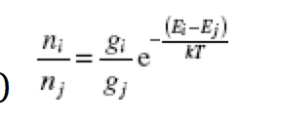
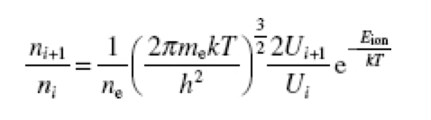
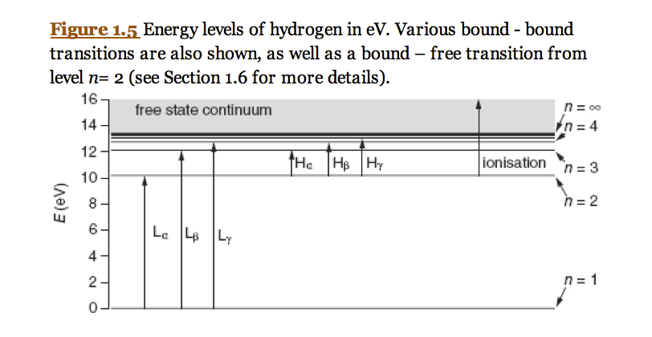
Why do the spectra look different with T?
Boltzmann Equation – excitation states :
Saha Equation – ionization states :

Slide 7
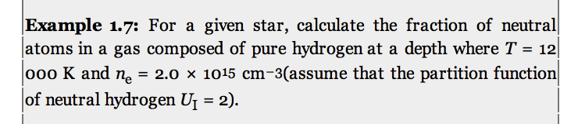

Slide 8
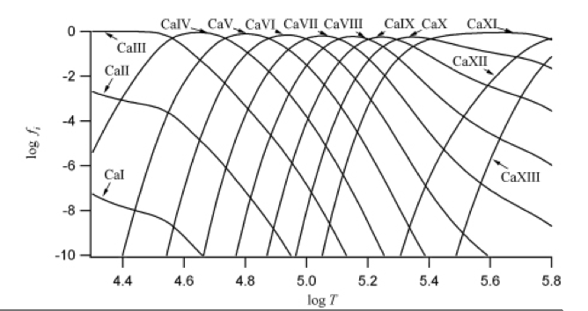
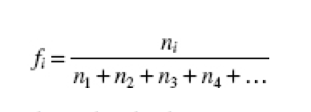
Can do these calculations for any atom
Notes:
Can see that there can be several ionization stages at a given temperature: in the Sun, we see Ca I & Ca II in the optical.

Slide 9
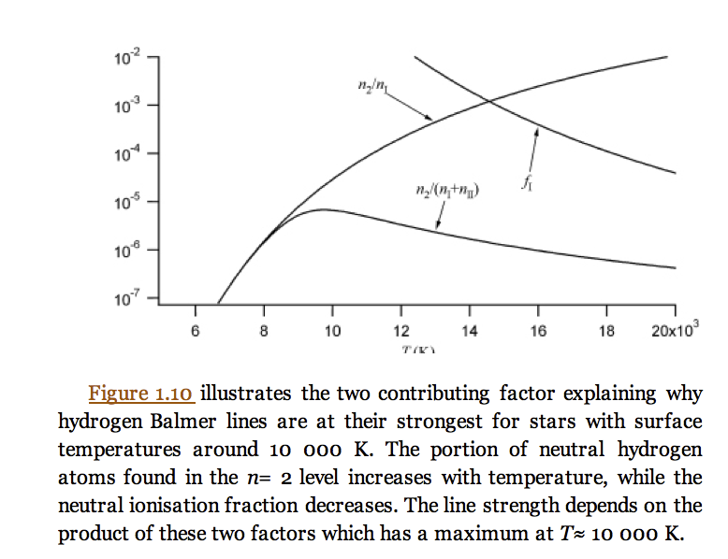
Hydrogen sensitivity to Temperature
Temperature (K)

Slide 10
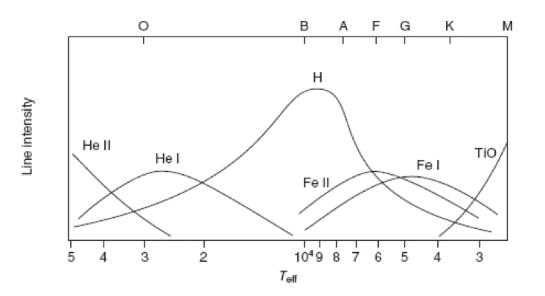
Competition between excitation and ionization
determines when line intensities are strongest

Slide 11
Balmer lines of H
SUN
Molecular features
Notes:
Balmer lines of H weak in the Sun (because n_2 is low – mostly in n_1)
Balmer lines stronger in hotter stars as n_2 > n_1
Balmer lines weak again in hottest stars as n_II > n_I

Slide 12
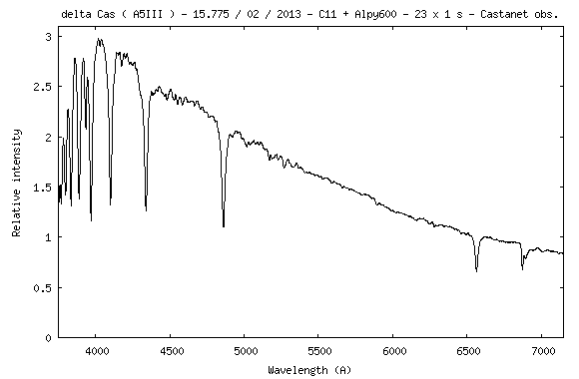
Notes:
Estimate the temperature – 30,000 K

Slide 13
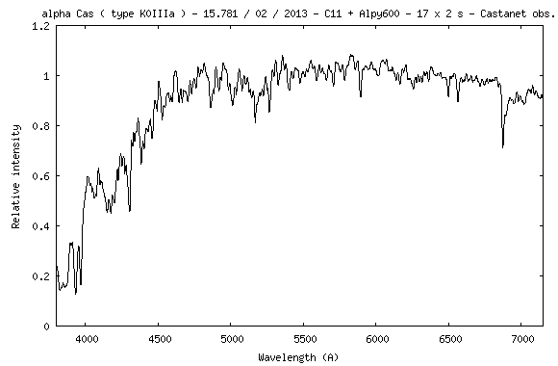
Notes:
Estimate the temperature – 4000 K

Slide 14
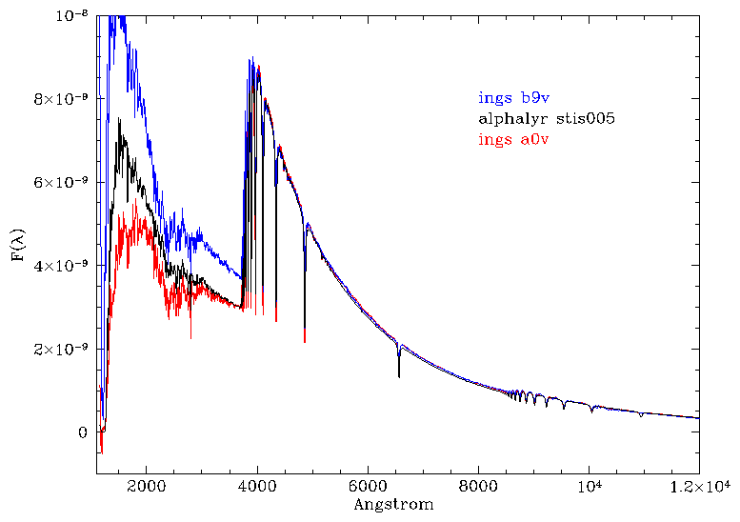
Radiative Transport
Notes:
Basic Blackbody physics works well – but real spectra require more details, e.g., here we are looking at MORE of the wavelength coverage of spectra – what the hell?!

Slide 15
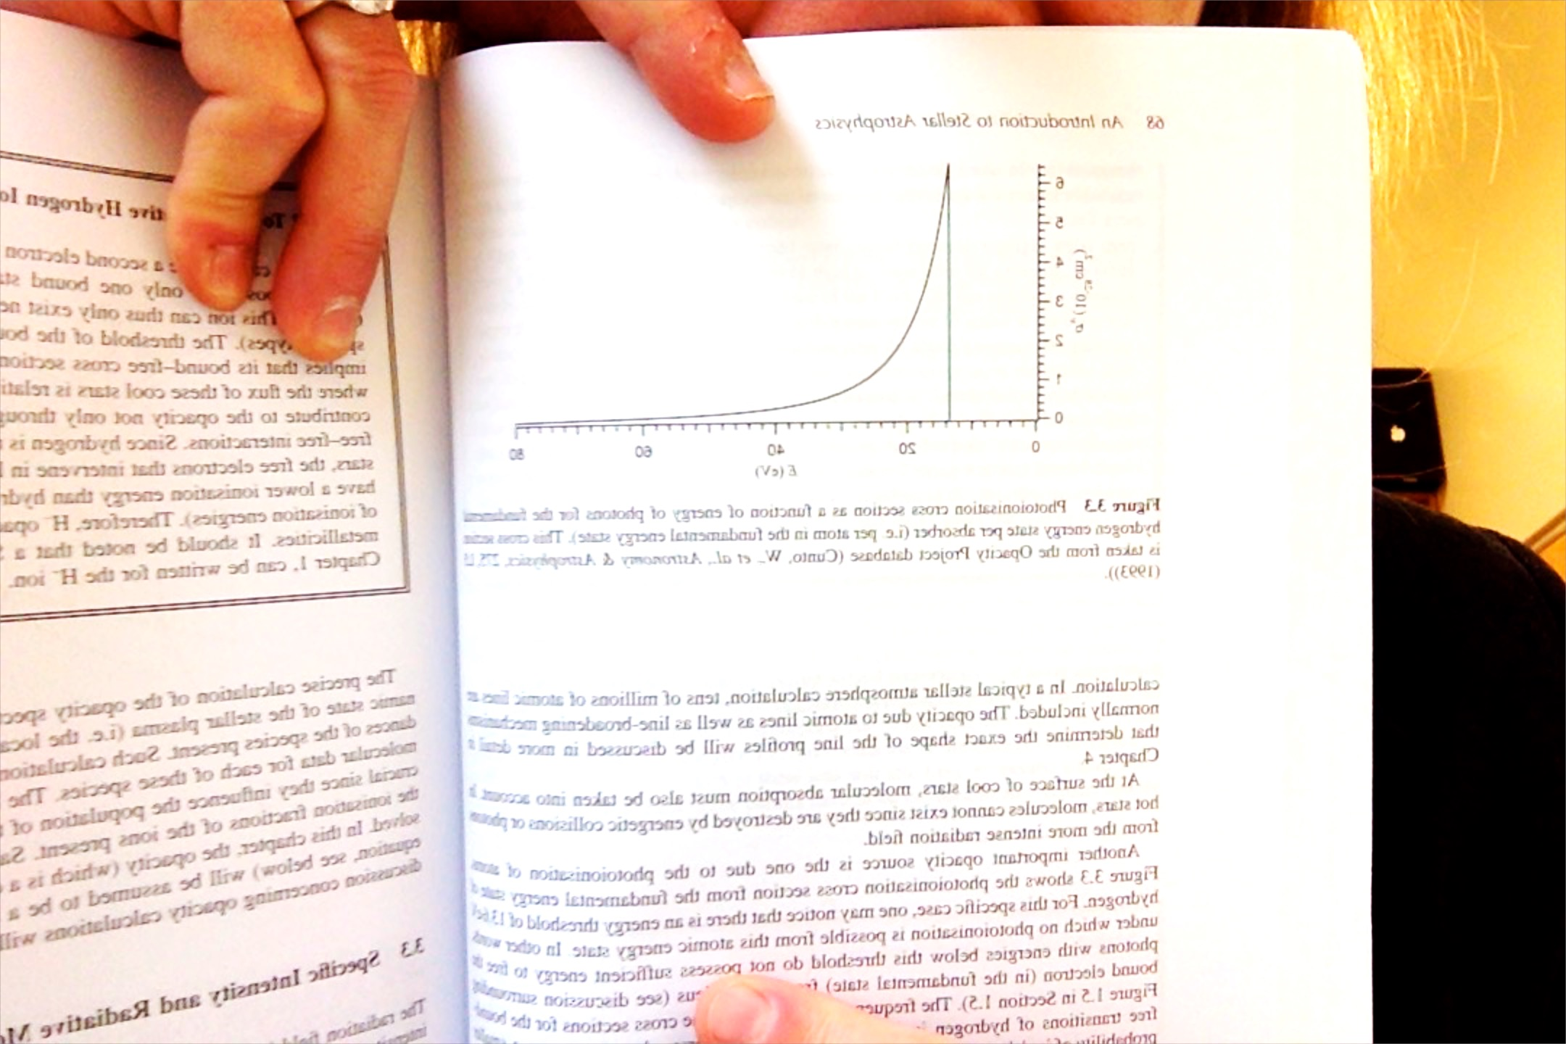
Effects of Photoionization on a Spectrum
Any photons above the energy
threshhold can photoionize the
bound electron, with excess energy
transforming into its kinetic energy.
For E_{n=1} = 13.6 eV
For E_{n=2} = 13.6/4 = 3.4 eV
Photoionization cross sections
(σ_{ν} x 10⁻²⁸ cm²) ~ 1/ ν³

Slide 16
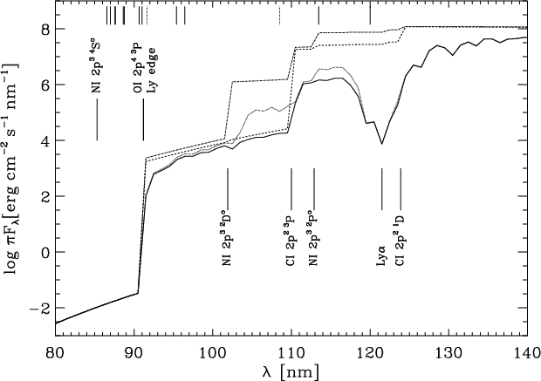
Przybilla & Butler 2001 Astronomy & Astrophysics 379, 955
T=10,000 K
UV spectrum
Notes:
Other elements also have photoionization edges.

Slide 17
Radiative Opacities in Stellar Atmospheres
Four Types of Radiative Opacities:
- bound-free transitions
- bound-bound transitions
- free-free transitions (near an atom, changes energy)
- scattering processes (does ~not change wavelength)
Radiative Opacity: the ability of matter to absorb or scatter photons.
- In most stars, collisions dominate therefore thermalizes the radiation field
(T_{rad} = T_{eff}), and the Saha-Boltzmann equations determine atomic populations.
- electrons dominate collisions ( ½ mv² = 3/2 kT ), i.e., smaller m means higher v.
- thus, the statistical equilibrium of the atomic populations is dominated by
electron-atom collisions (not, e.g., atom-atom or photon-atom).
Notes:
Need to know about opacity sources

Slide 18
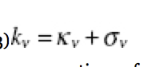
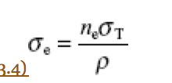
Opacity: (cm⁻¹)
(Eq 3.2 reversed words) ρ = mass density (g/cm³)
k_{ν} = “radiative opacity” = cross section per mass (cm²/g)
absorption processes
scattering processes
One dominant form of scattering in most stellar atmospheres is from free electrons
(recall: Thomson scattering), which is ~ independent of frequency. Thus,
= 6.6524 x 10 ⁻²⁵ cm²
Notes:
Write up on board first!!
Beware the overuse of “sigma” (cross section and scattering opacity)

Slide 19
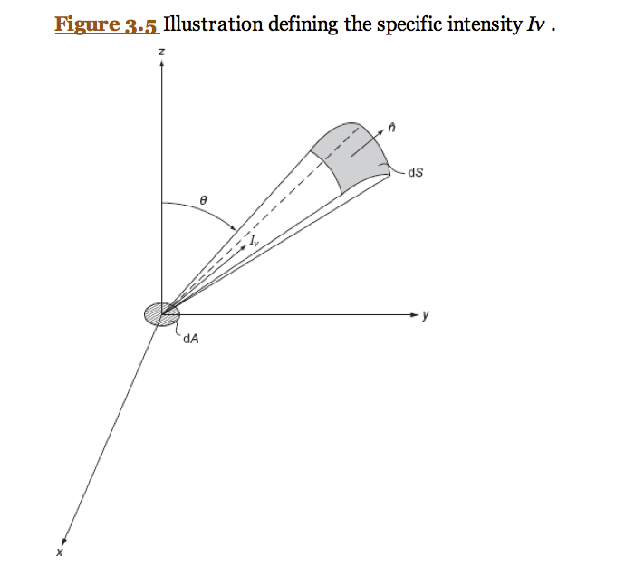
Specific Intensity
Notes:
And we need to know about intensity of light along a beam - Definition & theory behind I_nu ** notes for the board!

Slide 20
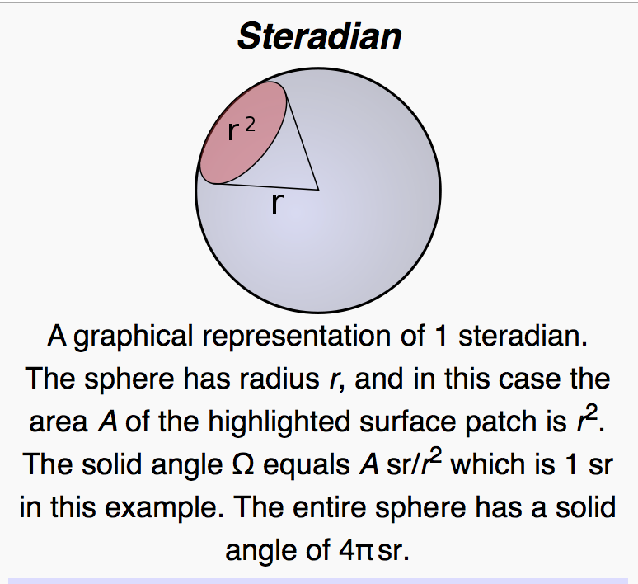
Specific Intensity
Notes:
And we need to know about intensity of light along a beam - Definition & theory behind I_nu ** notes for the board!
Follow the units : erg/s per Hz per cm2 per sr

Slide 21
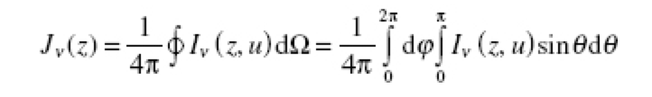
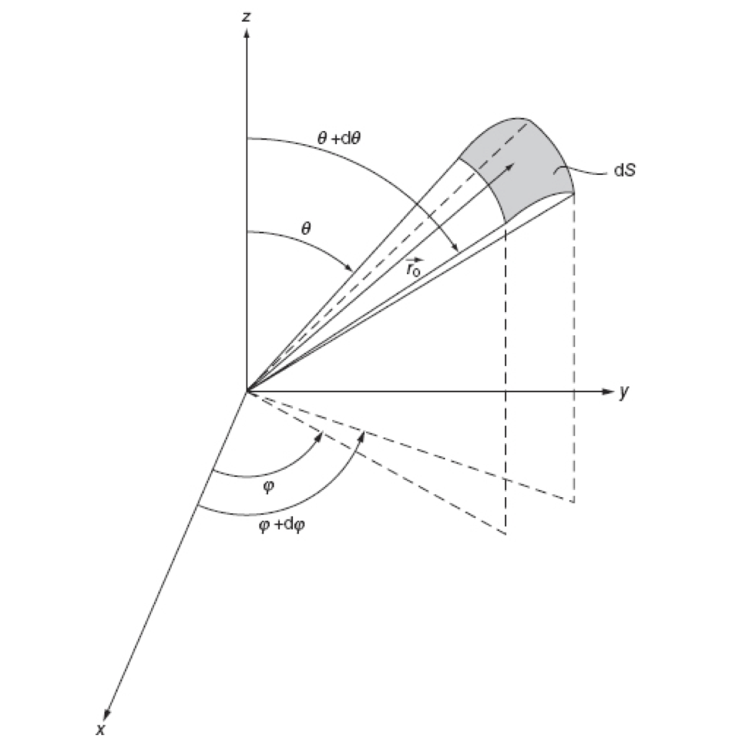
Average Intensity
Notes:
Mostly reminder of solid angle and integral limits on those angles theta and phi

Slide 22
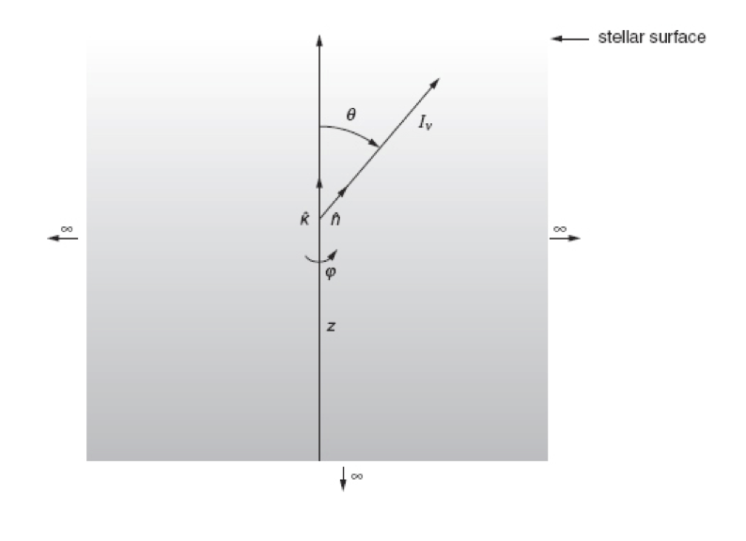
Specific Intensity, estimated as a vector
Notes:
Since specific intensity is per solid angle, then not strictly a vector, but we can estimate it assuming sr→ 0

Slide 23
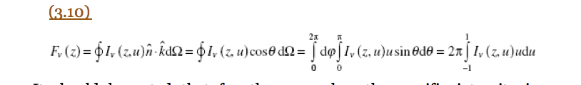
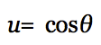
(Monochromatic) Radiative Flux
Notes:
Use specific intensity (vector) to describe/define (monochromatic) radiative flux
Notice that I_nu relates to Flux, and the simple SB Law.

Slide 24
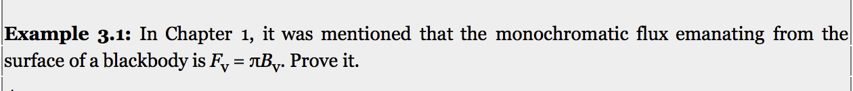
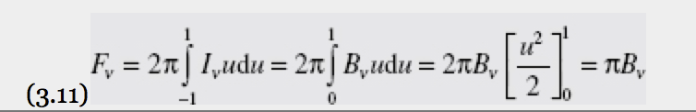
Example where I_{ν} is B_{ν} - at the surface of a blackbody.
To solve this, we use that “by definition the specific intensity at the surface of
a blackbody is equal to B_{ν} for 0 < u < 1 and nil for -1 < u < 0. “
Thus, isotropic at the surface, in the outward direction only.
Calculation then of the monochromatic flux is

Slide 25
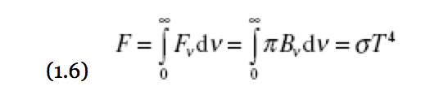
(Monochromatic) Radiative Flux
Notes:
Use specific intensity (vector) to describe/define (monochromatic) radiative flux
Notice that I_nu relates to Flux, and the simple Stefan-Boltzmann Law.

Slide 26
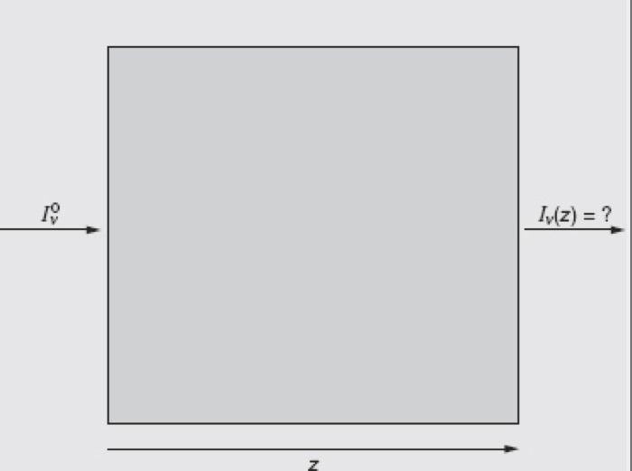
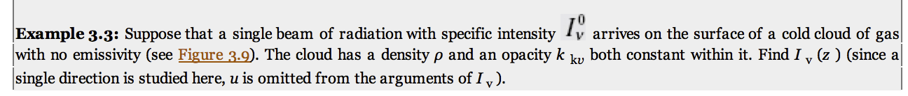
Radiative Transport

Slide 27
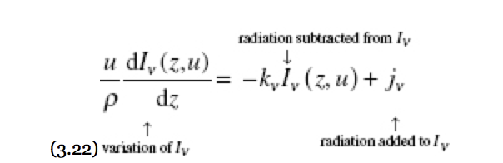
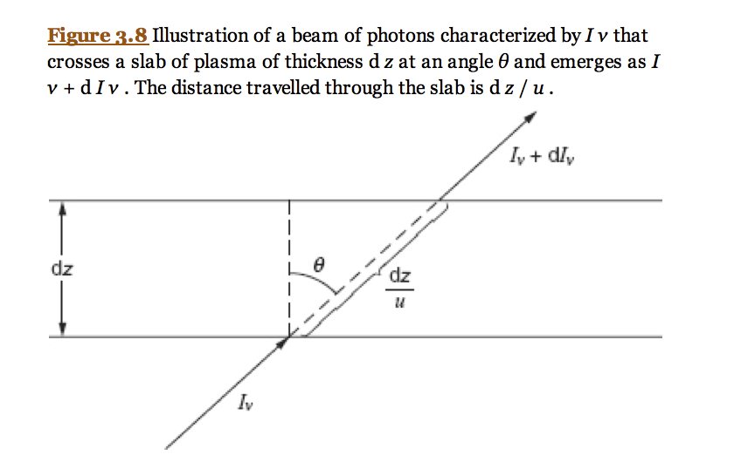
Radiative Transfer Equation
Notes:
Zoom in on the little cylinder, orient along z so that I_nu not necessarily perpendicular to cylinder, but instead along z, I_nu(z,u)

Slide 28
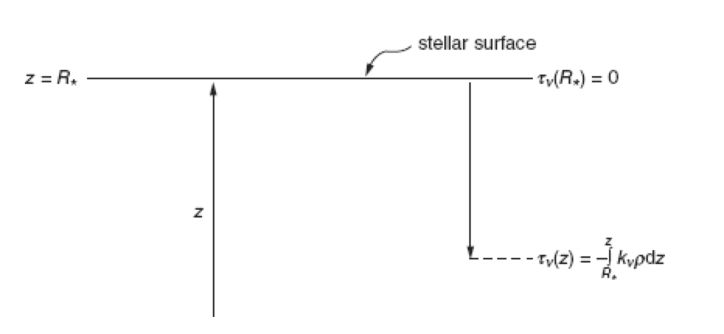
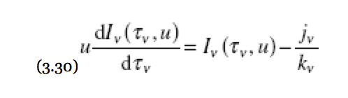
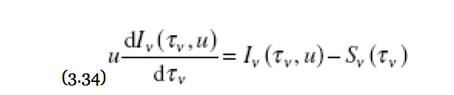
Optical Depth
Optical depth defines
the opaqueness of a gas
at a given frequency
reason why stellar spectra
are from the surface layers.
Deeper is “optically thick”,
( 𝝉= 1 )
Notes:
Laying at night watching the sky, and see a plane move through a cloud. Optically thick when you cannot see the blinking lights.

Slide 29
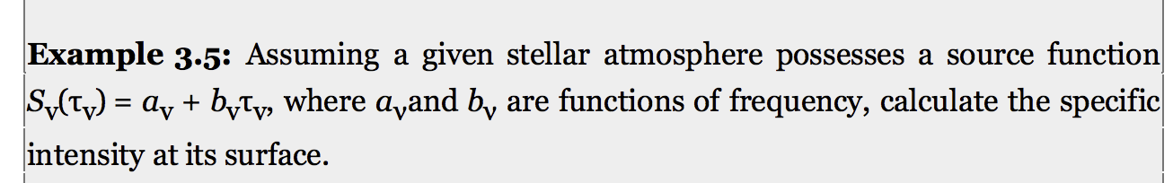
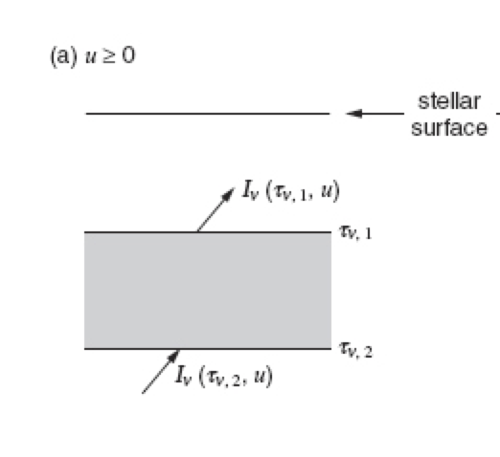
z₂
z₁

Slide 30
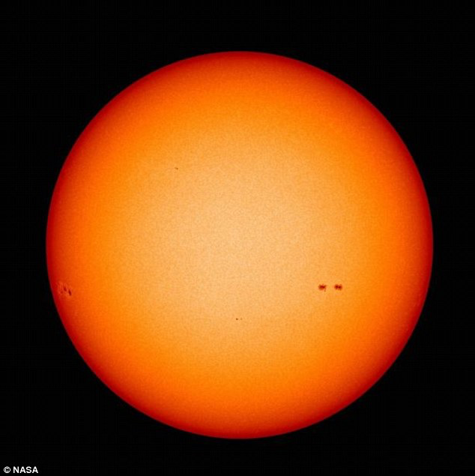
Radiative transfer through a block of gas is still relevant for real stars because the
stellar atmosphere is much thinner than the radius → “plane parallel approximation”
But real stars have
T gradients.
(e.g., seen as solar
limb darkening)
Notes:
We have been describing a block of gas, with a given T, density, and opacity.
But real stars are not like this.

Slide 31
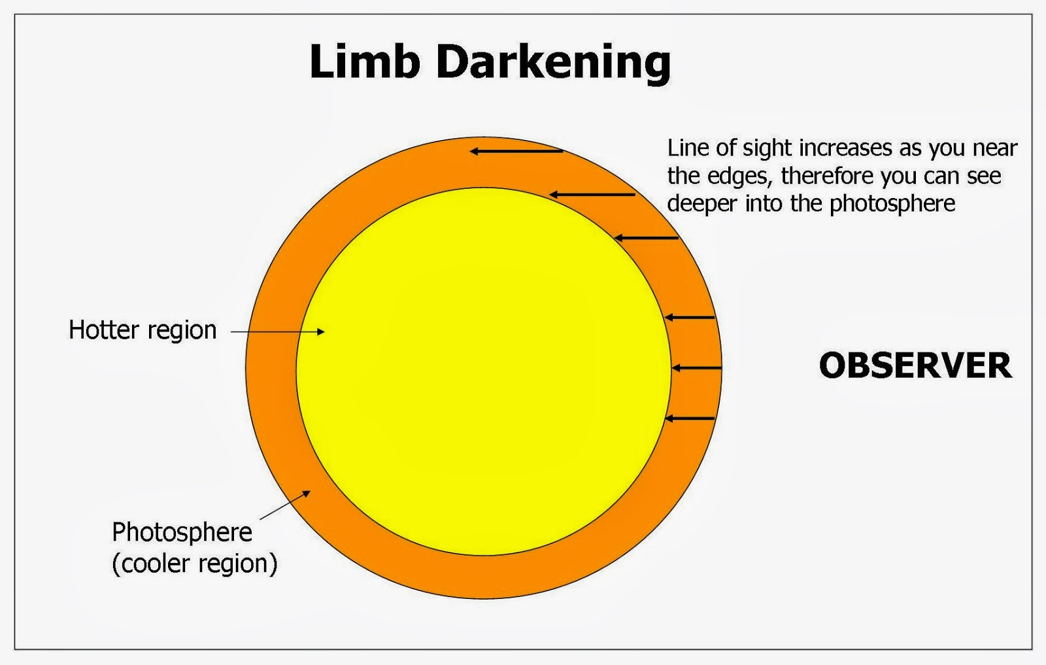
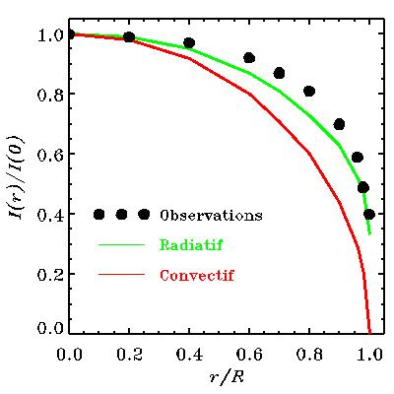
I = a +b u
Schwarzschild 1906
Notes:
Careful with the angles!! From centre of star, vs from observer (u= cos(theta)
What is “Radiatif vs Convectif in that diagram – surface of Sun is convective!

Slide 32
We used Ex. 3.5 to examine a linear source function → limb darkening
I = a +b u
z₂
z₁
Notes:
Notice the layer of gas used in this problem. How about a stack of these layers?
Plane parallel okay since atmosphere about 1% of most stars.

Slide 33
Plane parallel model atmosphere
- Energy transported by radiation (not convection, and with no E sources)
Integrated radiative flux is constant, but not F_{ν}
Assume static (convective cells Δ r << atmosphere size)
Outside atmosphere, intensity decreases with 1/r²
T₁ ne₁ κ₁ τ₁
T₂ ne₂ κ₂ τ₂
T₃ ne₃ κ₃ τ₃
T₄ ne₄ κ₄ τ₄
T₅ ne₅ κ₅ τ₅
T₆ ne₆ κ₆ τ₆
…

Slide 34
Plane parallel model atmosphere
Assume Local Thermodynamic Equilibrium
(local T defined by collisions, Maxwell-Boltzmann distribution function)
Mean free path of particles << distance for T change
Implies S_{ν} (τ_{ν}) = B_{ν} (τ_{ν})
Atomic populations are defined by the local T (Saha & Boltzmann Eqns)
T₁ ne₁ κ₁ τ₁
T₂ ne₂ κ₂ τ₂
T₃ ne₃ κ₃ τ₃
T₄ ne₄ κ₄ τ₄
T₅ ne₅ κ₅ τ₅
T₆ ne₆ κ₆ τ₆
…

Slide 35
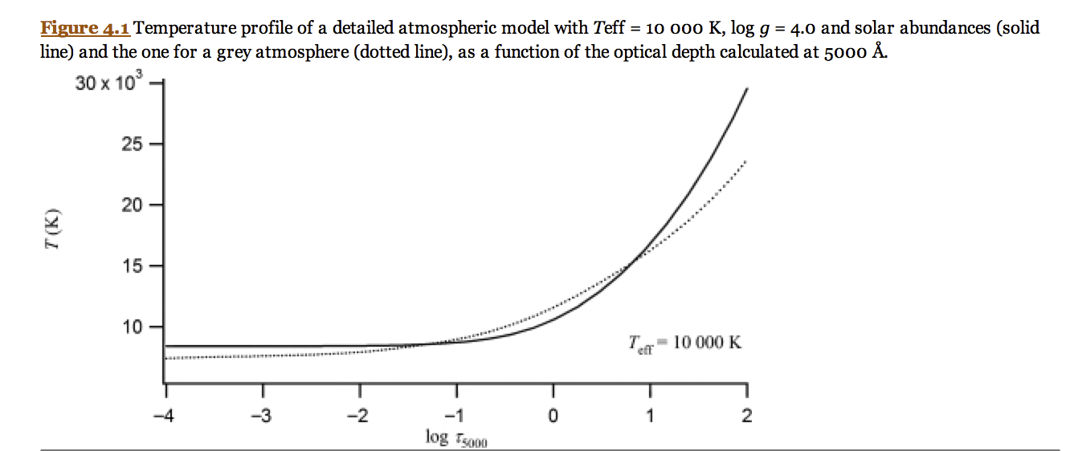
Define a Temperature Structure
Vega (A0 V)
+ knowing atomic populations and opacity sources, κ_{ν} (T)
then can reconstruct the spectrum from B_{ν} ( τ_{ν}=1) → I_{ν} ( τ_{ν}=0)

Slide 36
Define a Temperature Structure
& Spectrum
Vega (A0 V)
Vega (A0 V)
Flux
Wavelength

Slide 37
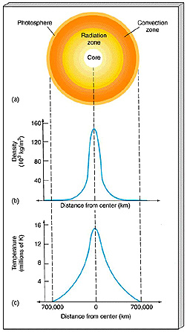
Model Atmospheres extend to Stellar Interiors
Once you have a temperature structure,
T ( τ_{ν} )
Then the ideal gas equation can give you
a pressure gradient
a density profile
a mass profile
A convection criterion
An energy generation profile
And our assumptions about radiative
transfer can be extended to optically
thick and hotter interior regions –
Notes:
Whole star – where optical depths can be large too.
With T profile, can determine others given ideal gas law.
Important in the interior (Ch 5 – later).

